Slide 1
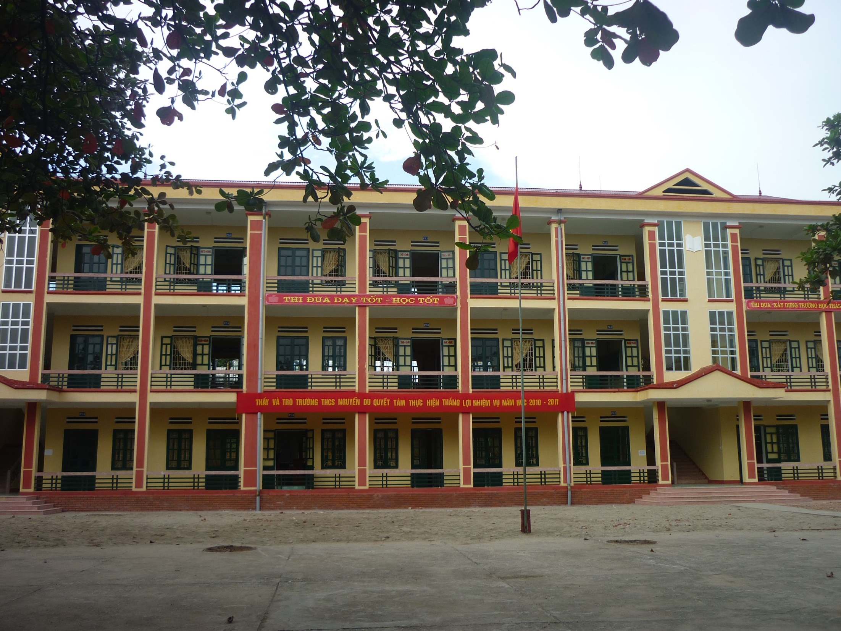




NICE TO MEET YOU!
Welcome to our class!

Slide 2
Grade 8 – Week 23rd
Unit 11: Traveling around Viet Nam
Lesson: Getting started + Speak + Listen + Read

Slide 3

I. Vocabulary
ocean (n) :
oceanic (adj) :
oceanic institute (n)
đại dương
thuộc về đại dương
viện hải dương học
2. accommodation (n):
accommodate (v) :
chỗ ở
cung cấp chỗ ở
3. departure (n) :
depart (v) :
sự khởi hành
khởi hành
4. fly (v):
flight (n) :
bay
chuyến bay
5. mountain (n):
mountainous (adj):
miền núi
thuộc miên núi

Slide 4
6. florist (n) :
người bán hoa
7. offshore islands (n) :
những hòn đảo ngoài khơi
8. giant Buddha (n) :
tượng Phật khổng lồ
9. waterfall (n) :
thác nước
10. tribe (n) :
tribal (adj) :
tribal village (n)
bộ tộc
thuộc về bộ tộc
bản làng
11. recognize (v):
recognition (n)
công nhận
sự công nhận
12. World Heritage Site (n) :
Di sản thế giới
13. magnificence (n):
magnificent (adj)
hùng vĩ

Slide 5
II. Grammar
Request (Gợi ý) | Reply (Trả lời)
 | Agree (Đồng ý) | Disagree (Không đồng ý
1. Do/ Would you mind + Verb-ing? (Làm phiền bạn ... được không?) Would you mind opening the door? ( Làm phiền bạn mở cửa được ko?) | - No, I don’t mind. - No, of course not. - Not at all. | - I’m sorry, I can’t. - I’m sorry, that is not possible.
2. Do you mind if I + Verb1? (Bạn có phiền nếu tôi...?) Do you mind if I turn on the TV? (Bạn có phiền nếu tôi mở cửa?) | - No, I don’t mind. - No, of course not. - Not at all. - Please do. - Please go ahead. | - I prefer you didn’t. - I’d rather you didn’t. (Tôi mong bạn không làm.)
3. Would you mind if I Verb2/ Verb-ed? Would you mind if I listened to the radio? Would you mind if I sang a song?

Slide 6
READ
* Matching:
- World Heritage Site:
- recognize (v):
- cave (n) :
- limestone (n):
- magnificent (adj) :
đá vôi
đầy ấn tượng, lộng lẫy
công nhận , thừa nhận
di sản thế giới
hang , động

Slide 7
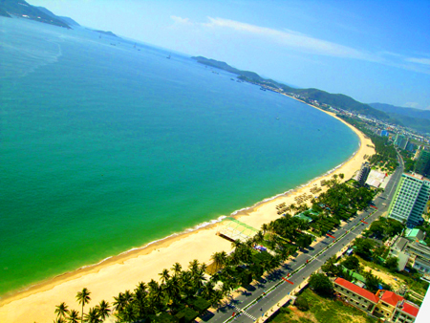
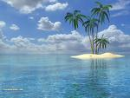
NHA TRANG
Seaside resort
*Sights
giant Buddha*
Oceanic Institute
offshore Islands
*Accomodation
A small selection of hotels
*Arrivals / Departures
Flights daily to Ho Chi Minh City except Monday
Flights to Ha Noi twice a week
Buses and trains to northern and southern destinations

Slide 8
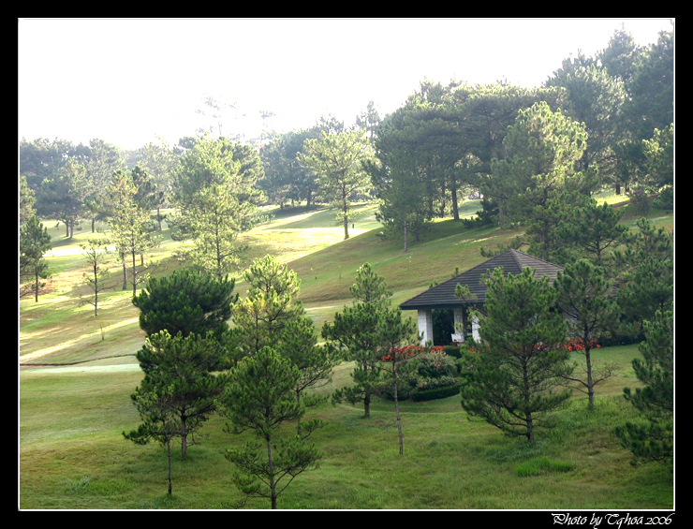
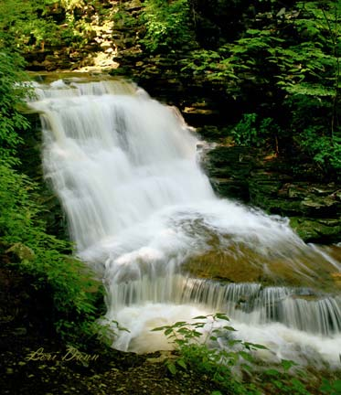
DA LAT
Known as the city of
Eternal Spring
*Sights
Waterfalls, lakes,
Railway, Flower gardens
*Accommodation
Many hotels, but difficult to
find accommodation at busy times.
*Arrivals / Departures
Flights to and from Ho Chi Minh City three times a week
Buses and minibuses to Nha Trang and Ho Chi Minh City
Eternal (adj) :
Waterfall (n):
vĩnh hằng
thác nước

Slide 9
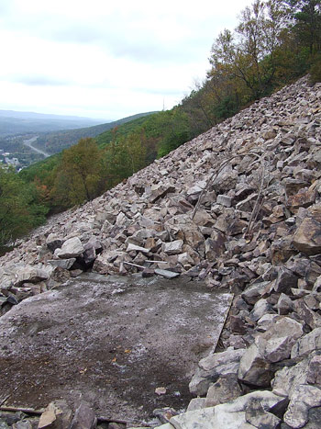
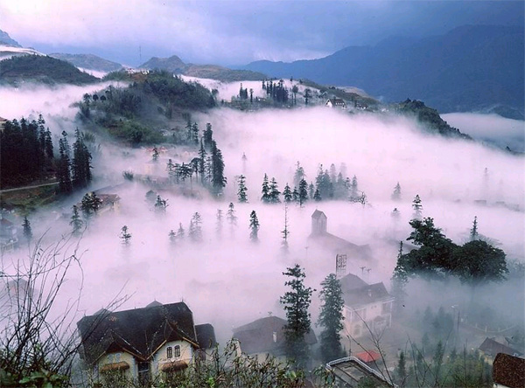
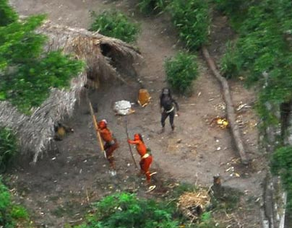
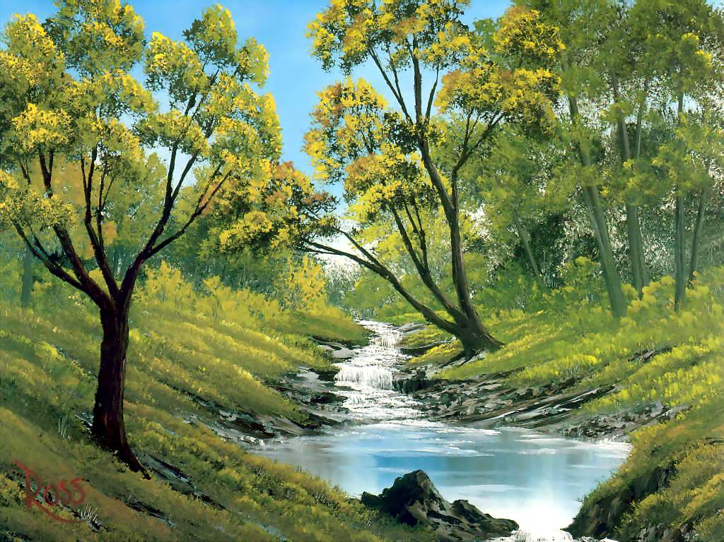
SA PA
Moutainous resort
*Sights
Tribal villages
Beautiful mountain slopes
Jungle streams
*Accommodation
Some hotels and guest houses
*Arrivals / Departures
Buses daily to Lao Cai Town
Trains daily from Lao Cai to
Ha Noi
tribe (n.)
tribal (adj.)
slope (n.)
stream (n.)
tribe (n) : bộ tộc, bộ lạc
tribal (adj)
slope (n) : dốc, độ dốc
stream (n): suối

Slide 10
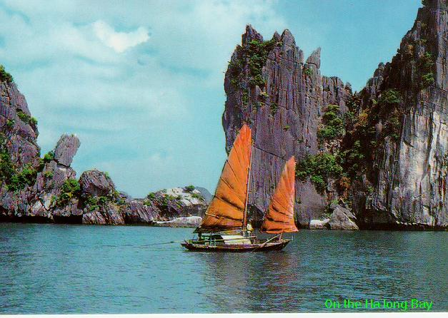
HA LONG BAY
Recognized by UNESCO as
a World Heritage Site
*Sights
Magnificent caves, beautiful limestone islands, quiet sand beaches
*Accommodation
Hotels and mini-hotels in
Ha Long City and various islands.
*Arrivals / Departures
Buses and trains daily to and from Hai Phong and Ha Noi

Slide 11
III. Practice
A. Multiple Choice
1. Would you mind if I took a photo ?
Please go ahead B. Yes, I mind C. Yes, please D. No, I wouldn’t
A. Please go ahead
2. Do you mind closing the door?
Yes, I don’t B. I prefer you didn’t. C. No, of course not D. I’m sorry, I can’t
C. No, of course not
3. Phong Nha Cave in Viet Nam is known __________ a World Heritage Site.
as B. that C. of D. like
A. as
4. Passengers should check in at least one hour before ______.
depart B. department C. departing D. departure
5. Donna works in a shop that sells flowers and plants; she's a _____
florist B. farmer C. gardener D. flower
B. department
A. florist
6. There are flights daily to HCM City _______ Monday.
A. on B. except C. besides D. after
B. except
7. Would you mind _________ me some paper from the desk?
A. to get B. get C. getting D. Got
C. getting
8. There was a __________ sunset that evening.
A. magnify B. magnificently C. magnificence D. magnificent
D. magnificent
9. It’s about _______________drive from the city center.
A. twenty minutes B. twenty-minute C. minute- twenty D. twenty-minutes
10. Ha Long Bay is recognized by UNESCO as a _______________________
A. World Heritage Site B. World Health Organization
C. Wonder of the World D. Friend of the Earth
B. twenty-minute
A. World Heritage Site

Slide 12
B. Word form
1. Every week, there are two _________________from Ha Noi to Nha Trang. (fly)
flights
2. It’s difficult to find ______________ at busy times in this town. (accommodate)
accommodation
3. The train made a late _______________________. (depart)
departure
4. Tim and Shannon want to visit an _____________institute in VN. (ocean)
5. My aunt lives in a _________________area of the country. (mountain)
oceanic
mountainous
6. Most tourists like visiting______________ villages. (tribe)
tribal
7. Ha Long Bay was ___________ by UNESCO as a World Heritage Site. (recognition)
recognized
magnificent
8. There was a ____________________ sunset that evening. (magnificence)
9. Are you a _________ or are you living there ? ( tour)
10. Shortly after our _________ in Dalat, Tom became very ill. (arrive)
tourist
arrival
C. Transformation
1. Will you post the letter for me ?
→ Would you mind …………………………………………?
2. Please put the vase on the desk.
→ Do you mind ………………………………………….?
3. Can I move the TV to the right corner ?
→ Do you mind if ……………………………………………?
4. Could I smoke ?
→ Would you mind ……………………………………………?
5. May I ask you a question ?
→ Do you mind ……………………………………………?
posting the letter for me
putting the vase on the desk
I move the TV to the right corner
if I smoked
if I ask you a question

Slide 13

HOMEWORK
- Learn new words by heart .
- Do more exercise.
- Prepare the next lesson: WRITE.

